Slide 1
Operating System Introduction
Dr.G.Kirubasri
Assistant Professor
CSE

Slide 2
Overview
What is OS? When it was introduced?
Why we need OS?
Functions of an operating System
Types of Operating system
Difference between 32-Bit vs. 64 Bit Operating System
Name some OS

Slide 3
What is HW?
Name some HW components and their functionalities.
What is SW? What are the types of SWs?
OS is a HW/SW?
How do you define an OS?
An Operating System (OS) is an interface between a computer user and computer hardware.
An operating system is a program that acts as an interface between the user and the computer hardware and controls the execution of all kinds of programs.

Slide 4
An operating system is a software which performs all the basic tasks like file management, memory management, process management, handling input and output, and controlling peripheral devices such as disk drives and printers
Some popular Operating Systems include Linux Operating System, Windows Operating System, VMS, OS/400, AIX, z/OS, etc.

Slide 5
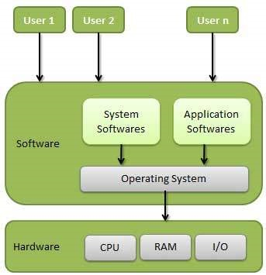

Slide 6
When the OS came into existence
Operating systems were first developed in the late 1950s to manage tape storage
The General Motors Research Lab implemented the first OS in the early 1950s for their IBM 701
In the mid-1960s, operating systems started to use disks
In the late 1960s, the first version of the Unix OS was developed

Slide 7
The first operating system sold along with a computer was invented by IBM in 1964 to operate its mainframe computer. It was called the IBM Systems/360...
The first OS built by Microsoft was DOS. It was built in 1981 by purchasing the 86-DOS software from a Seattle company
The present-day popular OS Windows first came to existence in 1985 when a GUI was created and paired with MS-DOS.
Five of the most common operating systems are
Microsoft Windows, Apple macOS, Linux, Android and Apple's iOS.

Slide 8
Why we need an OS?
Allows you to hide details of hardware by creating an abstraction
Easy to use with a GUI
Offers an environment in which a user may execute programs/applications
The operating system must make sure that the computer system convenient to use
Operating System acts as an intermediary among applications and the hardware components
It provides the computer system resources with easy to use format
Acts as an intermediator between all hardware's and software's of the system

Slide 9
The first OS built by Microsoft was DOS. It was built in 1981 by purchasing the 86-DOS software from a Seattle company
The present-day popular OS Windows first came to existence in 1985 when a GUI was created and paired with MS-DOS.

Slide 10
some of important functions of an operating System.
Memory Management
Processor Management
Device Management
File Management
Security
Control over system performance
Job accounting
Error detecting aids
Coordination between other software and users

Slide 11
Memory Management
Memory management refers to management of Primary Memory
Main memory provides a fast storage that can be accessed directly by the CPU

Slide 12
An OS does the following activities for MM
Keeps tracks of primary memory, i.e., what part of it are in use by whom, what part are not in use.
In multiprogramming, the OS decides which process will get memory when and how much.
Allocates the memory when a process requests it to do so.
De-allocates the memory when a process no longer needs it or has been terminated.

Slide 13
Processor Management
process scheduling?
In multiprogramming environment, the OS decides which process gets the processor when and for how much time
Keeps tracks of processor and status of process. The program responsible for this task is known as traffic controller.
Allocates the processor (CPU) to a process.
De-allocates processor when a process is no longer required.

Slide 14
Device Management
An Operating System manages device communication via their respective drivers. \
It does the following activities for device management
Keeps tracks of all devices. Program responsible for this task is known as the I/O controller.
Decides which process gets the device when and for how much time.
Allocates the device in the efficient way.
De-allocates devices.

Slide 15
File Management
A file system is normally organized into directories for easy navigation and usage. These directories may contain files and other directions.
An Operating System does the following activities for file management
Keeps track of information, location, uses, status etc. The collective facilities are often known as file system.
Decides who gets the resources.
Allocates the resources.
De-allocates the resources.

Slide 16
Other Important Activities
Security − By means of password and similar other techniques, it prevents unauthorized access to programs and data.
Control over system performance − Recording delays between request for a service and response from the system.
Job accounting − Keeping track of time and resources used by various jobs and users.
Error detecting aids − Production of dumps, traces, error messages, and other debugging and error detecting aids.
Coordination between other softwares and users − Coordination and assignment of compilers, interpreters, assemblers and other software to the various users of the computer systems.

Slide 17
Booting ?
is a startup sequence that starts the operating system of a computer when it is turned on.
A boot sequence is the initial set of operations that the computer performs when it is switched on. Every computer has a boot sequence

Slide 18
Kernel and Shell
What is a Kernel?
The kernel is the central component of a computer operating systems. The only job performed by the kernel is to the manage the communication between the software and the hardware.
A Kernel is at the nucleus of a computer. It makes the communication between the hardware and software possible.
While the Kernel is the innermost part of an operating system, a shell is the outermost one.

Slide 19
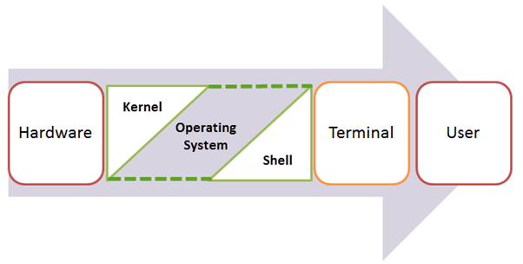

Slide 20
Types of Operating system
Batch Operating System
Multitasking/Time Sharing OS
Multiprocessing OS
Real Time OS
Distributed OS
Network OS
Mobile OS

Slide 21
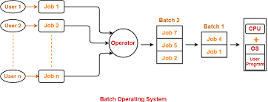
Batch Operating System
A job with a similar type of needs are batched together and run as a group.

Slide 23
EDITION 9
https://www.os-book.com/OS9/slide-dir/index.html
EDITION 6
http://bcs.wiley.com/he-bcs/Books?action=resource&itemId=0471250600&bcsId=1743&resourceId=2437
EDITION 5
http://fivedots.coe.psu.ac.th/~cj/os/slides/slide-ppt.html

Slide 24
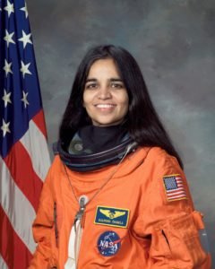
Who is the first woman of Indian origin in space?

Slide 25
GREEN TAX?

Slide 26
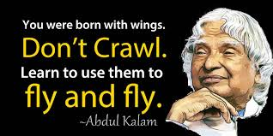
THANK YOU

